Slide 1
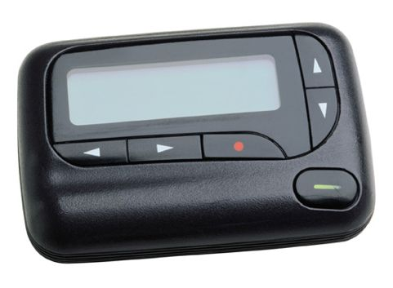
TTI: Top-10 On Call
Marja Anton, MD and Brian locke, md. Chief medical residents

Slide 2
outline x-Cover crash course
Sign out tips
Answering calls
5 most common
5 scariest
@UtahIMCMRS

Slide 3
Tips for Signout
@UtahIMCMRs

Slide 4
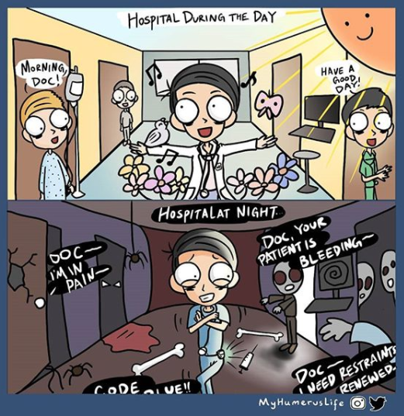
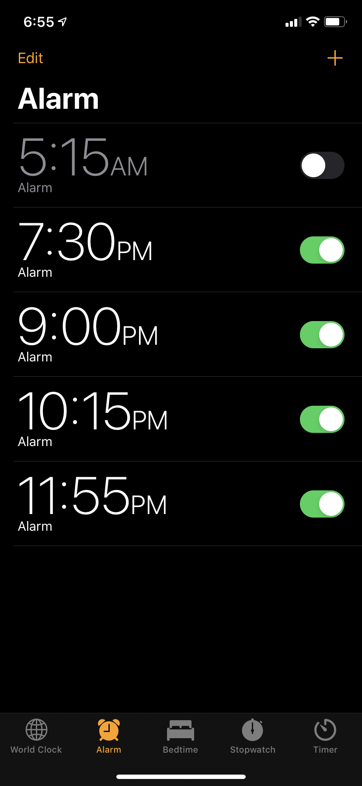
signout how to prioritize
@UtahIMCMRS
Notes:
Debated question: How in-depth? 15 second summary -> all 60 patients x-covering for (reasonable on medicine) => 15 minutes of straight signout. You can’t keep that straight. You need to prioritize. This is hard at first.
3 Objectives:
communicate who is sick and has the potential to decompensate
Communicate tasks that need to be completed overnight
Give a chance for questions on the plan.
My suggestion:
Tell me about folks might get sick, I need to do something on, and then visually scan through the rest to make sure if/thens make sense and you understand why.
A chance to double check:
Prns should be ordered by the day team for pain, sleep, nausea - if not, clarify why not.
Anything your following up on, there should be a plan for the expected results. This is the day teams job. No requests to followup without an if, then statement. They have 6-8 patients, you have 60 – it’s their job to think through as much as possible. NF should be like executing a control-flow diagram as above.

Slide 5
Handling calls
@UtahIMCMRs

Slide 6
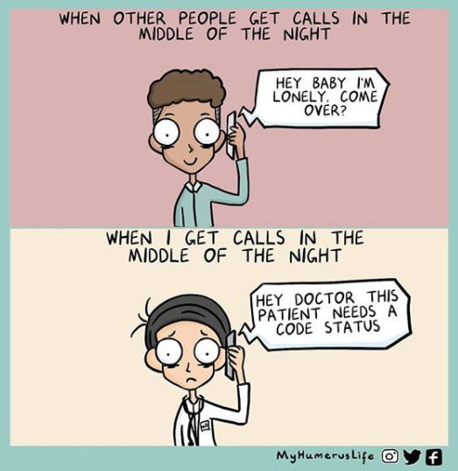
Calls how to Respond
@UtahIMCMRS
Notes:
Take notes on EVERYTHING you do.
-write notes on the chart whenever you start a medication
-write symptoms prns as 1x overnight, then tell the day team you had to order it
Rule #1: if a nurse is worried about a patient, you need to see them even if the RN’s explanation is not convincing… it may be that they just can’t articulate why they are worried, but the patient is sick. It’s on YOU to make sure this isn’t the case.
Rule #2: You will get stupid pages, but you CANNOT discourage nurses from paging you. If a nurse is dissuaded from paging you, eventually they are going to not page out of fear when it is important for them to page you. If you have a relationship of trust with the RN it may be OK to eventually give feedback (e.g. you don’t need to page for this) if they know you actually care and are coming at it from understanding. That’s not night 1
Rule 3#: You CANNOT, ever lie (or ‘fib’ / fudge), if you forgot something, or you didn’t check it – just say as much. If people (either RNs or day team) don’t trust you, you cannot function. This goes without saying, but is definitely more of an issue on night float.

Slide 7
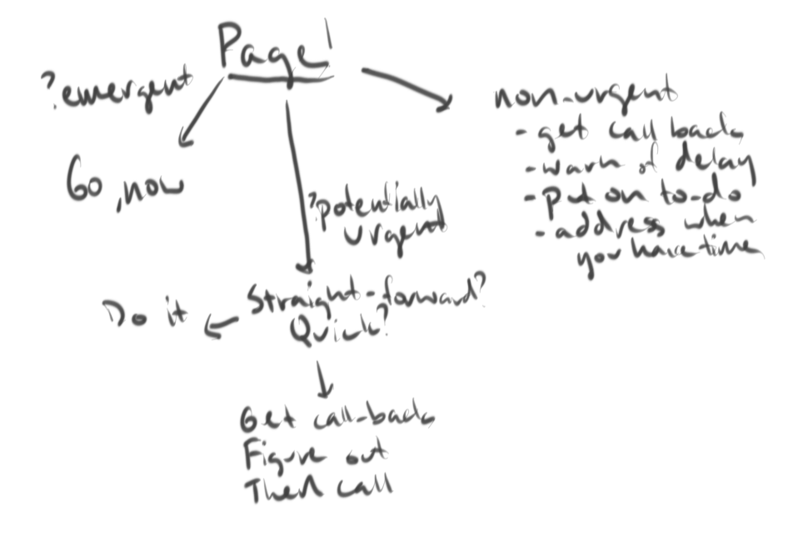
calls how to triage
Source: maidoodles.com
@UtahIMCMRS
Notes:
Is this (potentially) emergent => initial instructions and go to the patient immediately
If this is (potentially) urgent => deal with now. Depending how straightforward, may be appropriate to record RN’s number and look into it then call back.
This is not urgent => record on todo list, manage when it fits into your workflow. Warn RN of possible delay.
Used closed loop communication to ensure that you understand what their concern or need is. If it is not clear, ask directly / teachback (“So, am I right that X is the your main concern?”)

Slide 8
5 Most Common
@UtahIMCMRs

Slide 9
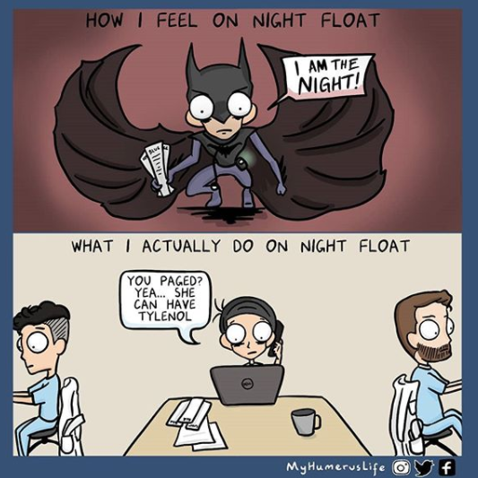
schemas 5 common calls
Can’t Sleep
Nausea
Pain
Constipation
Plan if fever
DAY TEAM PROBLEMS!
*DIRECT FEEDBACK IN AM IF RECURRING*
@UtahIMCMRS
Notes:
Early in intern year (and forever), nobody is perfect…. But the only way people can improve is if they know when they need to change. Be diplomatic and understanding about it, but don’t let it slide.
Patients will have unexpected issues where the day teams plan for each of these doesn’t work – that’s OK, but fixing those is beyond the scope of this talk.
Part of the early night float experience is learning what things you can include in your signouts / plans that will help your colleagues at night.

Slide 10
schemas 5 common calls
Problem | 1st Line | 2nd Line | 3rd Line | Note
Insomnia | Behavior (TV, lights off) | Melatonin 1.5-3mg before 12a | Trazodone 50mg* | Avoid Benadryl, Benzo
Nausea | Zofran* 4mg (IV if vomiting) | Promethazine* 12.5-25mg | Prochlorperazine* 5mg | Tigan, Ativan if QTc > 500
Pain | APAP** 975mg | NSAID** (Ibu 600mg) | Oxycodone 5mg | IV only if PO too slow and severe
Constipation | Miralax 17g | Senna 17.2g | Bisacodyl Supp. | All enemas** are equal.
* = check QTc, **esp. note for contraindications
@UtahIMCMRS
Notes:
2g APAP ok in cirrhosis, but avoid APAP in acute liver failure.

Slide 11
schemas 5 common calls
High BP
NPO, can they have X?
Wants to leave AMA
XX beats of NSVT
Insulin problems
@UtahIMCMRS
Notes:
We’re going to focus on 5 common calls that aren’t totally straight forward

Slide 12
How to approach high blood pressure
Page for High BP
End-Organ Damage?
Emergency, ICU xfer and immediate lowering
Specific Target? (eg. post-stroke, dissection, aneurysm) Lower now (IV vs PO)
Goal to lower BP in days to weeks. No IV meds. Resume home med vs defer to day
@UtahIMCMRS
Notes:
Schema:
Do they have symptoms / end-organ dysfunction because of the HTN?
Subset, is it making something worse, but not the cause?
Do they have a condition that requires a particular BP target? (stroke, dissection, aneurysm)
IV medications +/- transfer of care
If they have none of the above: goal is to lower BP over the next days to weeks.
Resume home antihypertensives if safe
Defer to day team
Reasoning? High BP does not significantly increase the risk of adverse outcomes over the short term. Known, real harms from rapid intensification of BP
No IV hydralazine. (? Pregnancy where fewer options are available)

Slide 13
How to approach NPO, meds/ice/sips
Type of Intake | Time prior to procedure
For patients NPO for a procedure. Assume all procedures will be bumped to 1st slot.
Meds w/ sip of H2O | Up to procedure if needed
Clear liquids, coffee | 2h before procedure
Solid Food | 6h before procedure
Fatty food / Tube feeds | 8h before
Indications for strict NPO:
GI track is blocked, perforated, or disconnected
Can’t swallow
Indications for pre-procedure NPO:
General anesthesia (ETT)
MAC / Procedural sedation
@UtahIMCMRS
Notes:
Does this patient w/ a procedure in the morning need to be NPO? If general anesthesia, regional anesthesia, or Monitored anesethsia care aka MAC-done by anesthesia- or procedural sections – done by proceduralist(=things like IR, cardioversion, joint reduction – no endotracheal tube, but all increase risk of aspiration) light meal – six hours, Heavy / fatty meal / tube feeds– 8 hours.
Note: assume ALL cases will be bumped up to first available slot 7-8a
Can this NPO patient have meds? If for procedure – yes, with small sip of water. If hole, blockage, or disconnection in GI track – no.
Can this NPO patient have sips/chips, clear liquids? Small amounts clear liquids up to 2h before. This includes coffee (w/ up to 50% milk) - https://annals.org/aim/fullarticle/2664126/annals-consult-guys-fasting-before-anesthesia-cappucino-call

Slide 14
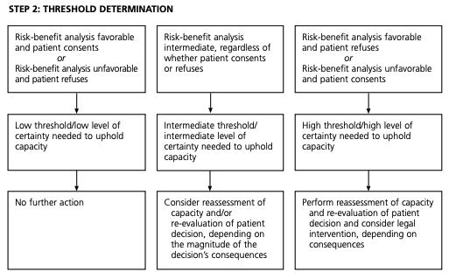
How to approach Leave AMA
Problem solve first:
Why? Can this be addressed?
Why does the team want them to stay? (how bad if they leave)
Only then, capacity
Source: Am Fam Physician. 2001 Jul 15;64(2):299-308
@UtahIMCMRS
Notes:
Note: restraints = has to be done by a resident (=has license) legally
Does this patient have capacity is underlying question. However, practical approach is different
Approach: trouble shoot why –
-why do they want to leave? Can this be addressed?
-why does the primary team want them to stay? (how bad would this be if they leave?)
Capacity assessment
4 things required:
Communicate choice
Understand the relevant information
Appreciate situation and consequences
Reason about treatment options
= specific to an individual questions (as in, you can have capacity to make a simple choice, but simultaneously not have capcity to make a consequential or nuanced decision). Competency is a legal issuef
= does NOT mean they have to ‘win’ an argument with you. If they have a reasoning based on an accurate and can communicate it
AMA does NOT influence billing
Involve seniors, approach to ‘harm mitigation’ differs unfortunately.

Slide 15
How to approach Non-sustained VTach
Causes of NSVT
Ischemia (esp if polymorphic)
EKG +/- troponin
Key Info:
Mono- vs Polymoprhic
Rate vs Duration
Presence of Symptoms
Long QTc (esp if polymorphic)
EKG +/- med list
Electrolyte Abnormalities
Check K, Mg (and Ca)
Decompensated Heart Failure?
Cause vs Effects?
Observe
@UtahIMCMRS
Notes:
Key approach: make sure this isn’t something dangerous. Otherwise, no intervention. (CAST trial)
Classify: How long (longer = worse), how fast (faster = worse), and what morphology (polymorphic = worse)
Symptoms: Chest pain? (ischemia), Lightheadedness? (perfusion)
Causes of NSVT:
-ischemia (esp polymorphic)
--eval w/ EKG, +/- troponin (never troponin without EKG – that tells you about what was going on in the heart 6h ago. We’re interested in now)
(ideal if can also capture the NSVT on EKG to help differentiate SVT w/ aberrancy)
-Long qt (esp polymorphic, called TdP)
--eval w/ EKG +/- medlist check
Electrolyte abnormalities
--eval with BMP (K, Ca), magnesium
Structural heart disease (?CHF exacerbation) – are they otherwise decompsnating?

Slide 16
How to approach insulin on NF
“Patient is NPO for surgery tomorrow, give the Glargine?”
T1DM: Never hold long acting. Give 0.75-1 of normal dose
T2DM: Give 0.5-0.75 usual dose
“Patient’s BG is 450, what do you want to give?”
Why is BG high (missed dose, infection)?
Is there acidosis? BMP if BG > 300 in T1DM, 450 in T2DM
Extra to give: 1650 / Total Daily dose = how much 1u will lower BG
@UtahIMCMRS
Notes:
Patient is NPO – do you still want to give the insulin?
In theory, should be able to continue for all (because meals shouldn’t effect basal rate). However, most people are dosed slightly too high on their long acting (because it’s easier to take, and easier for MDs to titrate) and it’s hard to predict ahead ot time. Because hypoglycemia is worse than hyper, we hedge. If managed closely and long acting <60% of Total Daily Dosage, can move toward upper end of spectrum.
Hold mealtime
T1DM – never hold long acting insulin. - Give long acting at 0.75 to 1.0 of reg dose.
T2DM - .5 to .75
Patient is Hyperglycemic – what to do?
1. Why – did they miss a dose (usually) vs some unrecognized process (e.g. infection)?
2. Get BMP if 300+ in T1DM, 450+ in T2DM to exclude ketoacidosis
3. Estimate insulin needed (this is conservative):
if not on insulin as OP, TDD = 0.5 weight. If on, use their TDD
1650 / TDD = the amnt you expect 1u insulin to decrease their BG, called CF
If goal is 150. (Current – Goal) / CF = dose. Regular insulin is usually best here pk wise.
100 kg patient not on insulin = 50u estimate TDD. 1650 / 50 = 33 CF. 450 – 150 = 300 goal amnt to lower. 300 / 33 => 10u regular.
Pt on 80u insulin daily -> 1850 / 80 = 20 CF. 450 - 150 = 300 goal to lower. 300 / 20 => 15u regular

Slide 17
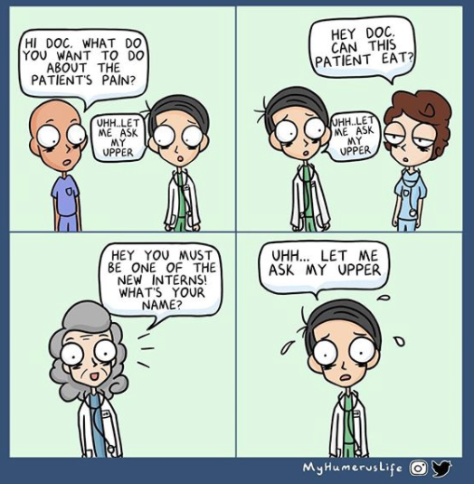
@UtahIMCMRS
Notes:
With all of these – you will often want to involve your residents. No shame in that - it is much, much easier as an upper level to manage an overly cautious intern than an overly confident one.
5 scariest on call covered by Dr. Anton.

